Slide 1


Slide 2
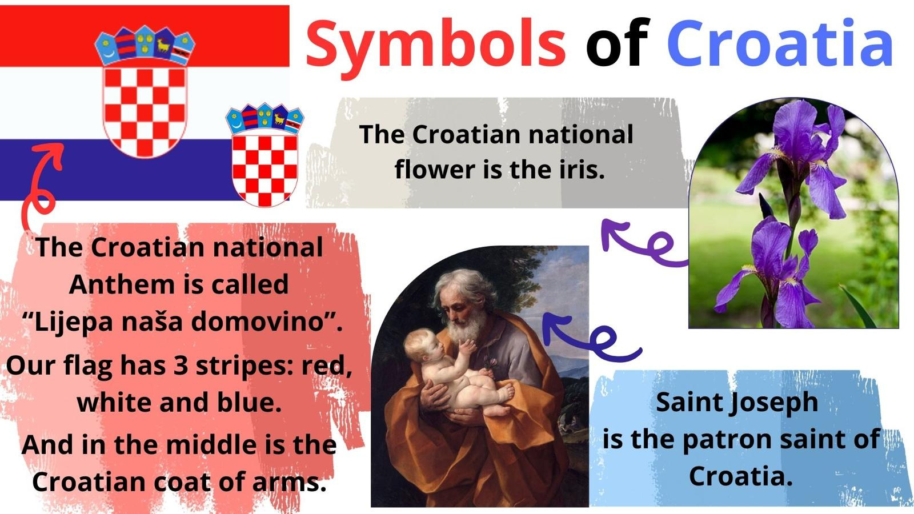

Slide 3
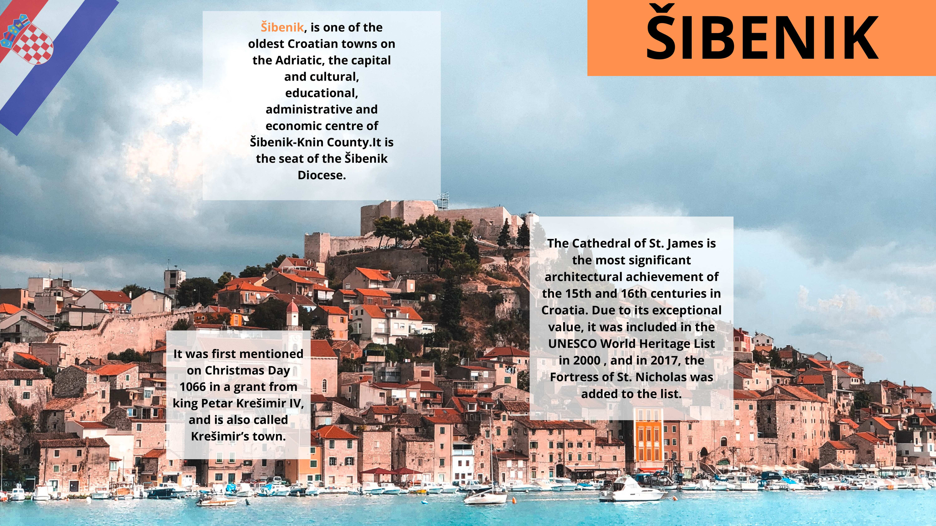
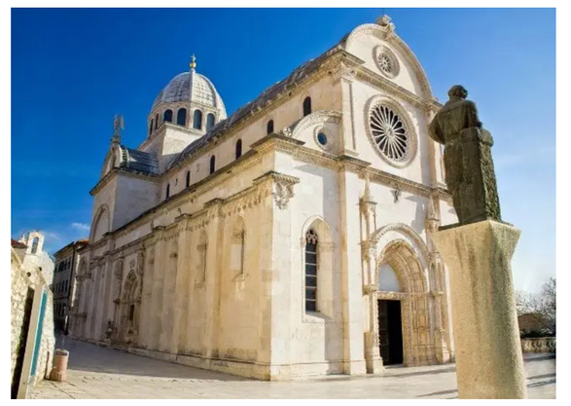

Slide 4
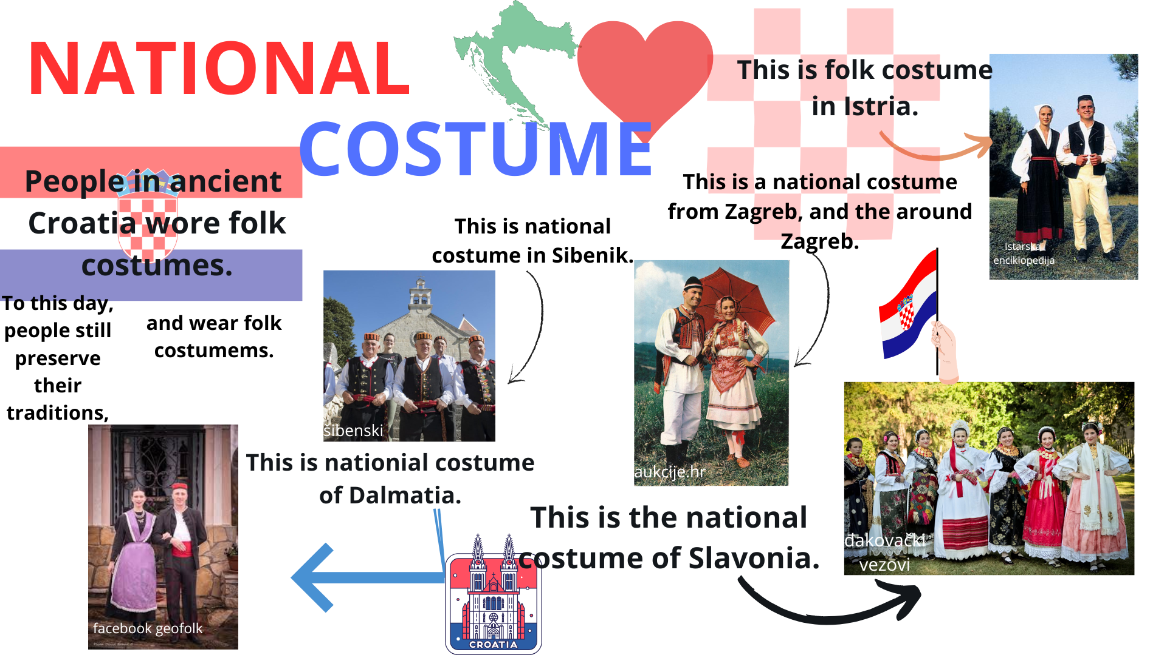

Slide 5





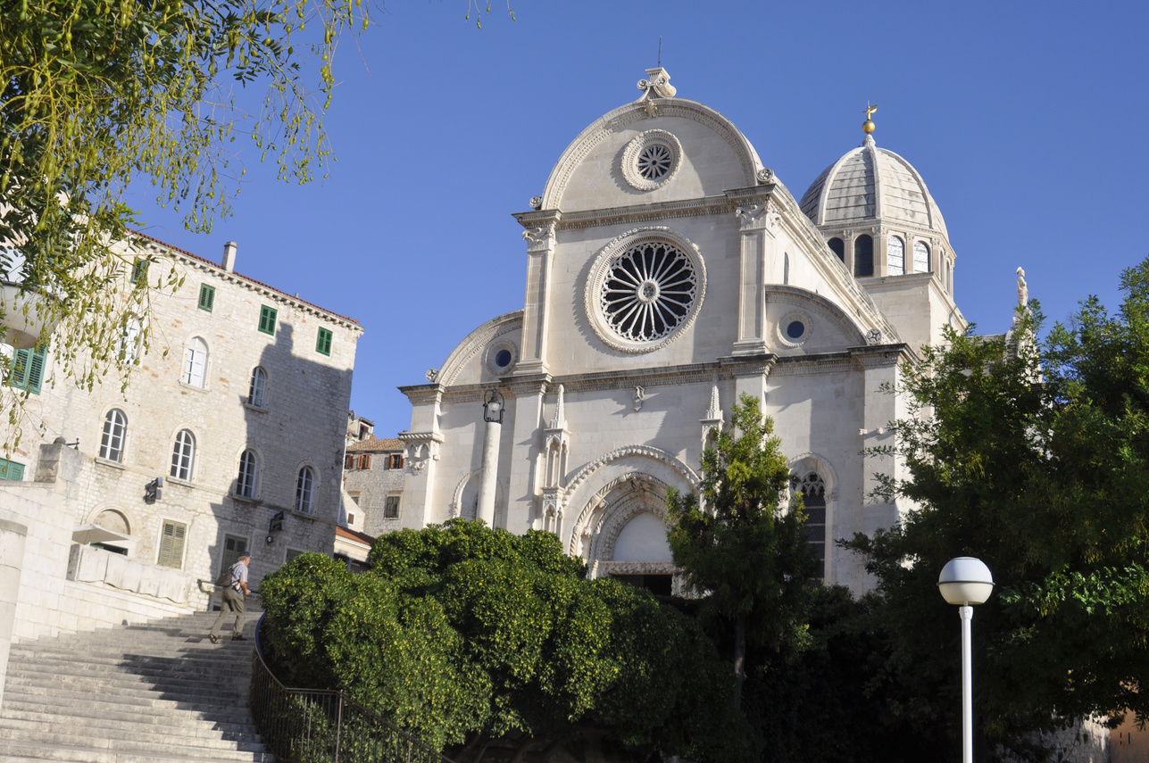
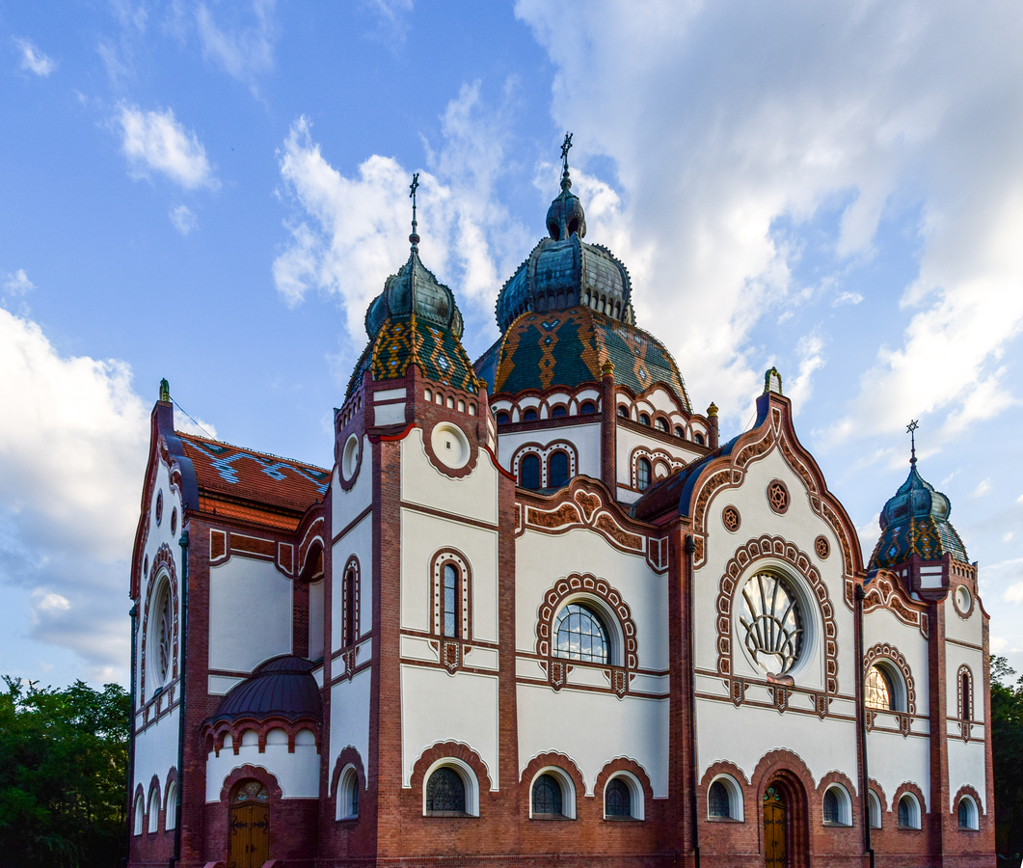
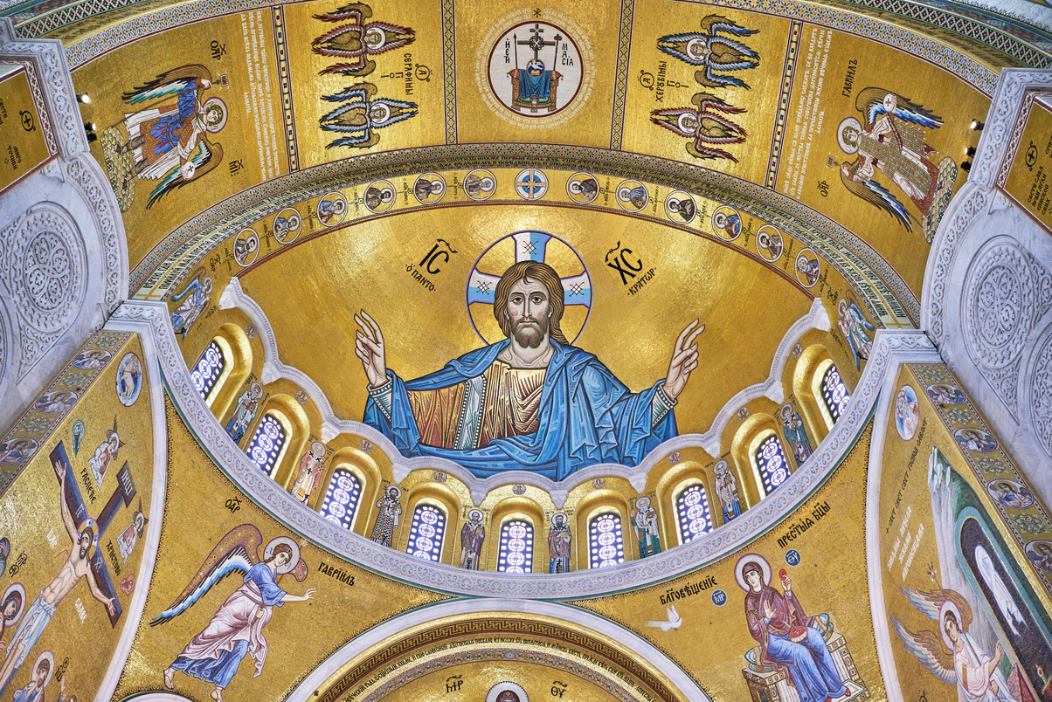
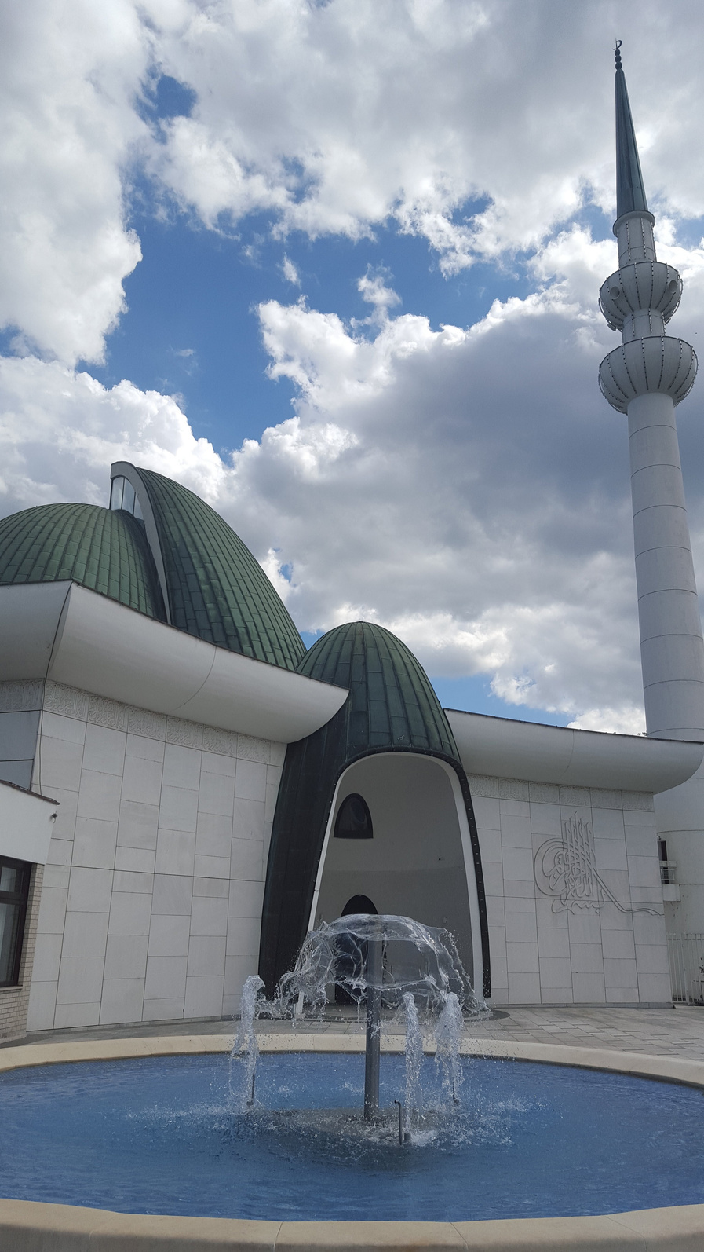
Religion
The most widespread religion im Croatia is Catholicity. Some of the minor religions are Islam, Judaism and Orthodoxy.
The gathering place od Christiana is the church.There are many churches ih all Croatian cities.

Slide 6
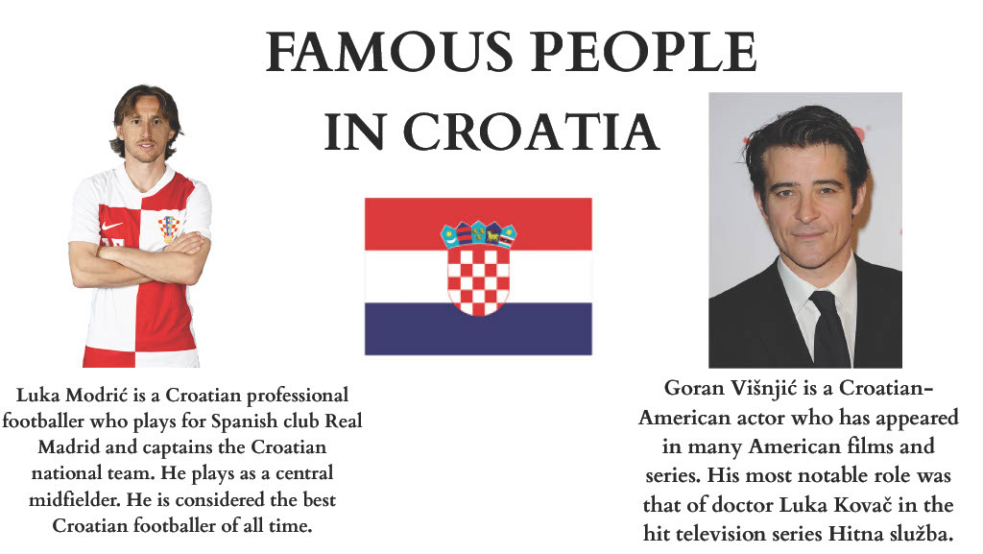

Slide 7
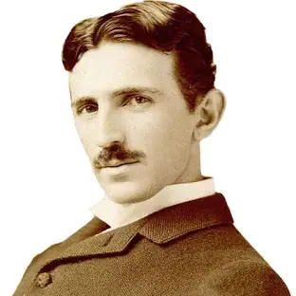
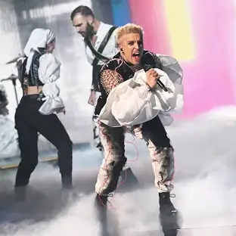
LISTEN
„RIM TIG TAGI DIM”
https://www.youtube.com/watch?v=YIBjarAiAVc
Nikola Tesla was famous inventor and engineer born in Croatia. He discovered and patented the rotating magnetic field.
Marko Purišić , known professionally as Baby Lasagna, is a Croatian singer-songwriter.
He represented Croatia in the Eurovision Song Content 2024 with the song „Rim Tim Tagi Dim”

Slide 8
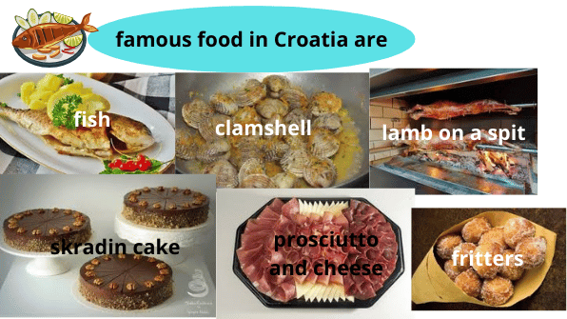

Slide 9
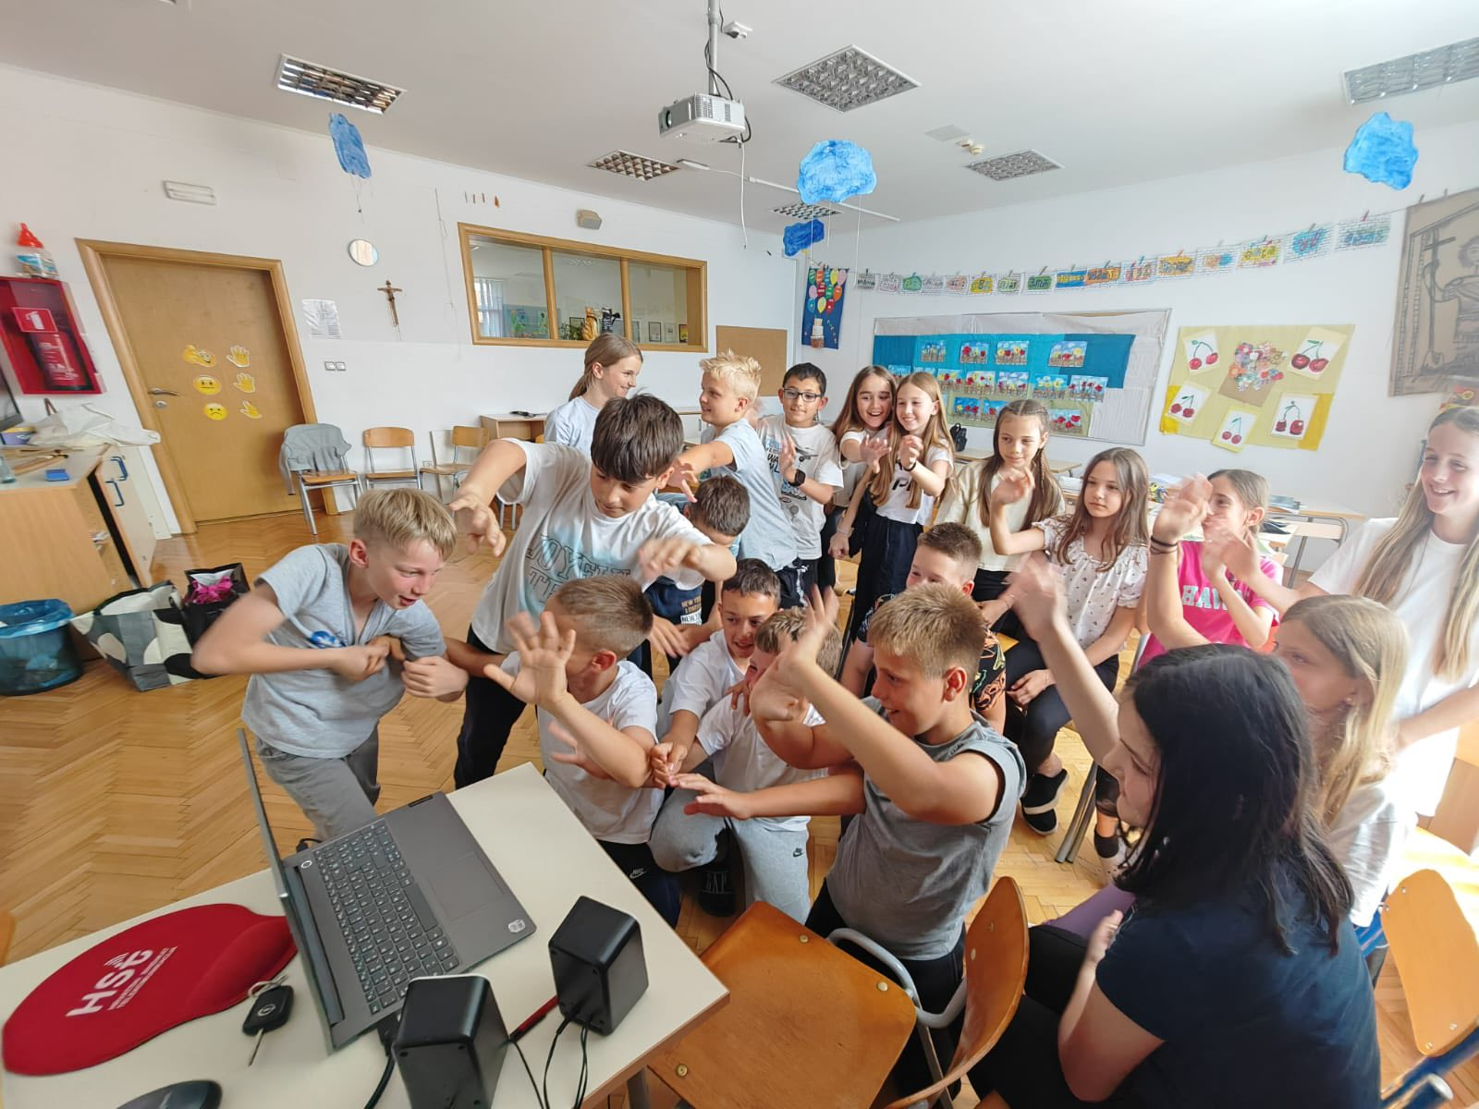
WE ARE HAPPY THAT WE MEET YOU AND WE HOPE, MAYBE SOME OTHER TIME, WE WIIL MEET AGAIN IN SOME ANOTHER PROJECT!!

